Slide 1

The New Format Paradigm
Jan Hutař
Digital Preservation Analyst
Archives New Zealand
jan.hutar@dia.govt.nz
DPTR workshop, iPRES2014, 07/10/2014 Melbourne

Slide 2
Session Outline
Defining a File Format
What are we trying to solve with DPTR Format Part
DPTR File Format Entities Definitions
Ongoing challenges

Slide 3
Defining a File Format
“packages of information that can be stored as data files or sent via network as data streams (aka bitstreams, byte streams). “ http://www.digitalpreservation.gov/formats/intro/format_eval_rel.shtml
“a standard way that information is encoded for storage in a computer file“ http://en.wikipedia.org/wiki/File_format
File format can be expressed in many different ways
specification – TIFF v6
extension – TIFF family
mime type etc
DPTR aims to accomodate and support different views

Slide 4
Defining a File Format cont.
format is an abstract entity in the DPTR model
DPTR brings 4 new concepts that extend the current way of talking about formats
3 new ways of format understanding: Specification, Implementation and Composition.
Aspect - the building block for those concepts.
Specifications, Implementations and Compositions are different forms of Format.

Slide 5
Current Universe
we have >
variety of file formats
valid, but unknown to PRONOM (.wbk; .ppp)
variety of non valid files
valid but reported as non valid files
we want >
to identify and reference varieties and versions
piles of the same shaped objects (consistency)
piles of v4, v5, v6 TIFFs rather than 1 fmt/353 pile
Notes:
So somewhere near the beginning of the file, there is the number 700 written in binary / hex code. According to the Official TIFF specifications, you should be able to follow this number with either a 1 or a 7. However, JHove doesn’t think so - if it sees anything other than a 1, it freaks out and says there's something wrong with the file (even though there isn't).
fmt/7 superseeded by fmt/353 which is general tiff ID, does not say anything about the tiff version

Slide 6
Current Universe cont.
not to ingest problematic (not valid) files - if possible
problems with tools (false alerts)
JHOVE 1.6 issue with the tag 700 in TIFF „I see 7 instead of 1“
wbk DROID extension mismatch
lack of tools – extractors, validators
dependency on PRONOM through DROID – many LTP systems able to use any registry, but in real using PRONOM
Notes:
sometimes we have to, if valid but the tool said it is not valid

Slide 7
Shifting Sources in the Format World
sources = content of current registries; websites etc.
ongoing change – like generic TIFF fmt/353 in PRONOM
not really user driven – institution driven
hard to follow – why my TIFFs were fmt/7 and are fmt/353 two years later?
sources and tools are scattered
Tiff v4 fmt/8
Tiff v3 fmt/7
Tiff v5 fmt/9
Generic TIFF fmt/353
Tiff v6 fmt/10
Notes:
fmt/7 to fmt/353 – we dont want that, have a rule to rewrite fmt/353 to fmt/7
not enough signatures, same signature for all 4 versions

Slide 8
What are we after?
be able to view diverse sources of format information in one place and in a homogeneous form;
define records that describe and identify very specific variants of formats;
have a full audit trail of change for records;
ability to build profile for an institution;
open, trusted and cooperative environment.

Slide 9
Sources for DPTR Format Part
bringing in the content of some of current sources
initial (one off) import and continuous import
shall create a reference-able source in DPTR
PRONOM, TOTEM, UDFR, TRiD, UNIX file, MediaPedia, internal registries of NLA, NARA
in theory any source can be imported
PRONOM
NARA
TOTEM
Notes:
any source can be imported – we are doing the ones we use - flat file DB import

Slide 10
Value added by DPTR on top of it
DPTR own input
imported sources auditing – timestamps, versioning etc.
ehancements
creating the relationships within format/other DPTR parts
adding new information
preservation analysts input – splitting up specifications
community input
tool development
PRONOM harvest 1
January 2015
PRONOM harvest 2
June 2015
PRONOM harvest 3
November 2015

Slide 11
Proposed DPTR Format Solution
allows us to describe the format world
as defined in specifications;
as found amongst digital objects “in the wild”;
offers information for identifying these descriptions;
will allow for varying levels of understanding of a format;
can be linked to collected associated sources;
can be linked to software, hardware and carrier media;
‘community text’ descriptions.

Slide 12
DPTR Conceptual Data Model
Relationships
Format
Hardware
IO Device
Carrier Medium
Software

Slide 13
DPTR File Format Entities Definitions
Specification
Implementation
Composition
Aspect

Slide 14
The Aspect
A discrete feature / characteristic of a format.
our term for a single element of information about the features or characteristics of formats
can be used to describe other information that may not be classed as a direct property of the file or format
building block for Specifications, Implementations, and Compositions - connecting relevant Aspects
different types of Aspects (structural, text based, informational, linking...)

Slide 15
The Aspect
Compression
Compression Type
LZW
[Aspect]
[Aspect Property Name]
[Property Value]

Slide 16
The Aspect
Compression
Compression Type
LZW
[Aspect]
[Aspect Property Name]
[Property Value]
[Aspect]

Slide 17
The Aspect
Compression
Compression Type
LZW
Text
[Aspect]
[Aspect Property Name]
[Aspect]
[Community Text]

Slide 18
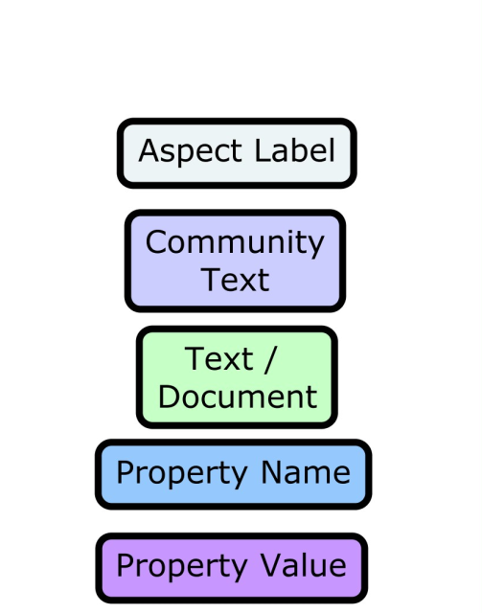
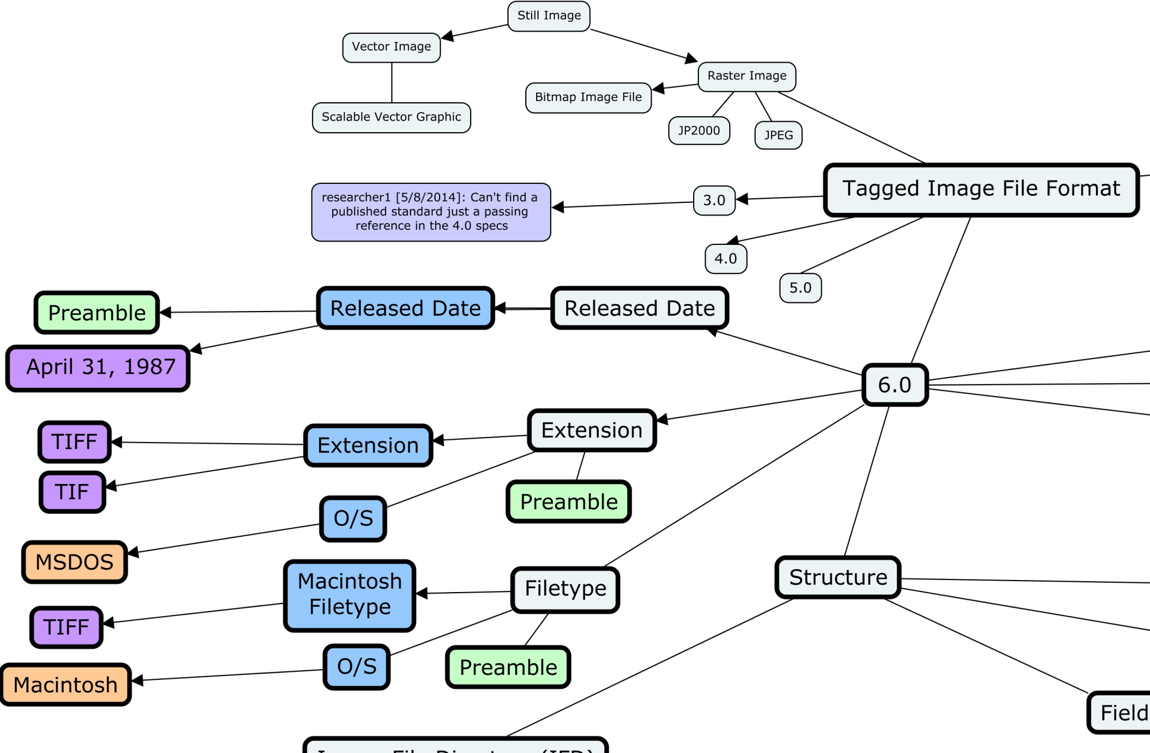
Top level TIFF example

Slide 19
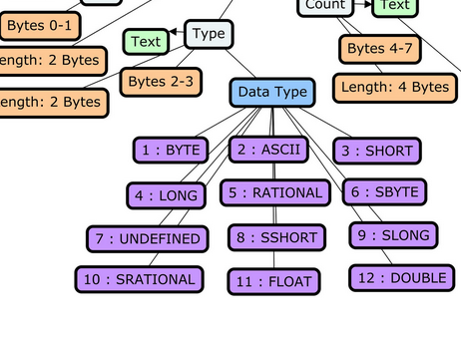
Aspect’s Values vs a Value
beside names, properties and IDs Aspects also have Values and Ranges

Slide 20
The Specification Object
A formal statement of the precise features and characteristics (Aspects) by which a format may be identified, i.e. a formal statement of the precise requirements which a format must satisfy.
defines the range of posibilities/Aspects outlined in spec
de jure standards, de facto standards
written or not (> Composition)
public or not public (> Composition)

Slide 21

The Specification Object
A5
Specification 1
A4
A3
Aspect 1
A2
A1
Specification 1
Aspect 1
Aspect 2
Aspect 3
Aspect 4
Aspect 5

Slide 22
The Implementation Object
An actualisation of a specification.
this is the real object (file) example build from Aspects
an instantiation of a format
can conform exactly or partially to a Specification
can contain features or characteristics that are not described in the Specification

Slide 23
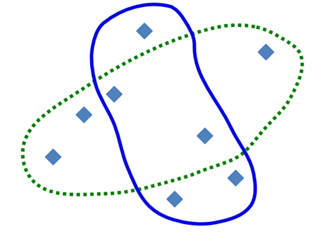
The Implementation Object
Specification 1
A6
A5
A4
A3
A1
A2
Implementation1
A8
A7
Specification 1 | Implementation 1
Aspect 1 | Aspect 1
Aspect 2 | Aspect 4
Aspect 3 | Aspect 6
Aspect 4 | Aspect 7
Aspect 5 | Aspect 8

Slide 24
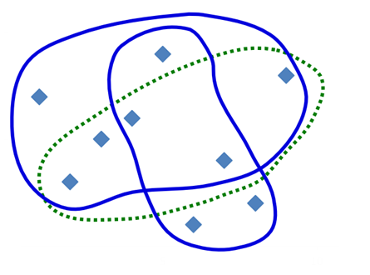
Two Implementations
Implementation2
Specification 1
A9
Implementation1
Implementation2
Aspect 1 | Aspect 6
Aspect 2 | Aspect 9
Aspect 3
Aspect 4
Aspect 5

Slide 25
The Composition Object
All of the Aspects associated with a format as manifested in all Implementations and a Specification.
can be seen as a ‘Format’ object
macrocosm of all the Aspects that are used across all related Specifications and Implementations
may contain other Aspects that are not part of a Specification or an Implementation

Slide 26
The Composition Object
Implementation2
Specification 1
A9
Composition1
Implementation1

Slide 27
Summary of Format Entities
aspects can provide required levels of granularity
our format model enables to understand, describe and reference deviations and varieties if necessary
each of shown entities can be considered as a ‘format’
Composition
Implementation1
Specification
Implementation2

Slide 28
Community Text
DPTR is description of entities – community text is ‘what I think about this’ and ‘what I have found about this’
can be connected to anything in the DPTR
institution related or general notes and facts
searchable
private or open
this will make the DPTR living platform for the DP community > knowledge base on top of the registry

Slide 29
Ongoing uncertain areas
the ‘language’ problem– terminology – difficult to find appropriate terms with no unwanted connotations and contexts
DPTR plans and ideas are big – is it achievable?
aspect typing – when do we know enough to freeze the status quo of Aspect types?
technology to make this work vs. conceptual model
lack of tools for analysis to generate the DPTR content
future tools for identification/validation based on DPTR
Notes:
difficult discussion about appropriate terms with unwanted connotations and contexts (find old names for entities)

Slide 30





Thank you for your attention

